Slide 1

Saving The Blinds From
Road Accident

Slide 2
Team Members
1. S. A Saleque Ahmed
2. Najifa Anjum
3. Mahedi hasan Tushar

Slide 3
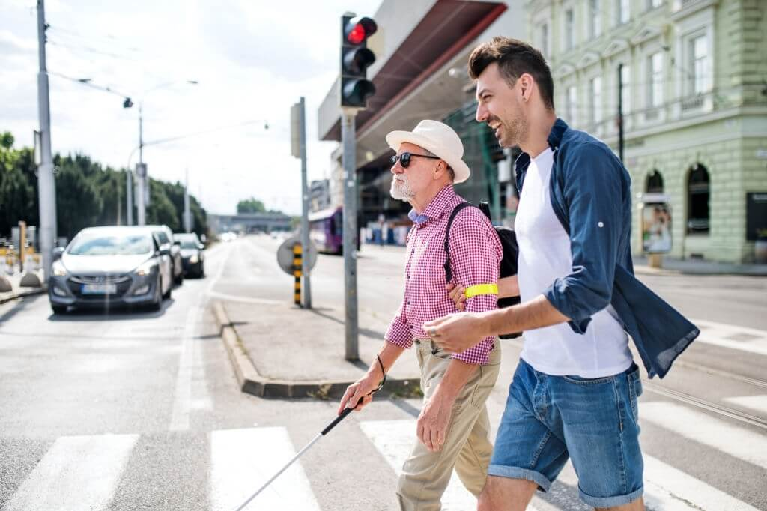
Introduction
We will develop a device through which a blind person can get indication about the running vehicles around him.

Slide 4
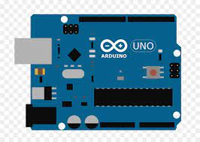
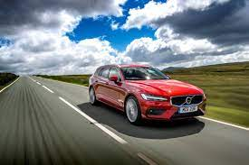


Processing
A blind person uses this device which send images of road to a server we have made. The server take the image and then detect vehicles and send response to the device. The server response a audio which tell the blind man how far vehicles are from him. Such as "Nearest Vehicle is around 5 meters close to you". it will give signal that tells the distance between the blind person . And the blind person gets alerted.
Request
Response

Slide 5
Thank You
Hope our project will help all the blind men, and it will append new dimension to visualize the world to them.

